Slide 1
Why Parenting Styles Matter
Changing the lives of Families in
Linn and Benton Counties
November 2011
Hosted by:
Parenting Success Network
Linn-Benton Community College

Slide 2
Stephen J. Bavolek, Ph.D. “Dr. B”
Author:
Nurturing Parenting Programs
Adult Adolescent Parenting Inventory (AAPI)
Executive Director:
Family Nurturing Centers, International
Asheville, North Carolina

Slide 3
Parent: Role or Identity?
Human Being?
OR
Human Doing?

Slide 4
Being v. Doing
Human Being: man, woman, boy, girl
Basic Needs
Social
Physical
Intellectual
Creativity
Emotional
Spiritual
SPICES of Life: getting your needs met daily

Slide 5
Doing v. Being
Family Roles: father/mother; brother/sister; grandmother/grandfather; aunt/uncle; son/daughter
Professional Roles: social worker; parent educator; soldier; banker; politician; lawyer; athlete; workshop attendee; workshop presenter
Community Roles: neighbor; volunteer; consumer; driver; pedestrian

Slide 6
Parenting is a Role
Parenting is the process of promoting and supporting the Social, Physical, Intellectual, Creative, Emotional and Spiritual development of children.

Slide 7
Parenting Styles
The beliefs, information, practices, skills and strategies that parents utilize in raising their children primarily learned in their childhood and replicated upon becoming a parent in their own right.

Slide 8
Traditional Parenting Styles
Permissive: sets no consistent guidelines; uses “OK”?” at the end of every request; does a lot whining.
My Way or the Highway: children are expected to be obedient, follow strict rules established by the parents, and “do what they are told to do, when they are told to do it because the parents said so!”

Slide 9
Traditional Parenting Styles
Empathic-Caring: parents help children learn to be responsible, make good choices, have clear expectations and involve children in making the and following the rules; gets their own needs met.
Abusive and Neglecting: lacks an empathic response to children’s needs; uses violence or the threat of violence; oppresses children’s power;

Slide 10
The Role of Personality in
Parenting Styles
Personality: the totality of an individual’s life experiences resulting in a “DNA of characteristics” which include perceptions, cognition, emotions and a steadfast social consensus all manifesting in observable and measurable behavior.

Slide 11
Nature vs Nurture
Nature: our “I”
The genetic predispositions we are born with.
Nurture: our “Self”
The environment’s impact upon our genetic predispositions

Slide 12
Research Findings
70% of our personality is developed from the way we are treated during our process of growing up (nurture).
30% of our personality comes from our nature, primarily physical and mental health conditions.

Slide 13
Understanding Brain Functioning
We are born with billions of cells that form cellular networks through neurotransmitters that need to be activated.
At birth, the baby’s brain is 25% - 30% of it’s adult size and only 20% to 30% functional
Interactions with other adults will stimulate the neurological connections and form networks.

Slide 14
Understanding Brain Functioning
The baby’s brain takes in experiences through it’s senses.
The brain will normalize repeated experiences creating healthy or diseased networks and pathways.
Behavior is the expression of repeated experiences – neurological pathways.

Slide 15
The I and the Creation of the Self
The “I” we refer to is our nature.
Our predisposed biological characteristics.
The “Self” we refer to is created from the nurture we experience. It is the expression of the “adapted” I.

Slide 16
Internal Voices and Conversations
80% of the word communication we use is internal.
20% is actually verbalized
“I hate myself!”
“I can stand being with my self!”
“I need to take better care of myself”
“Think I’ll do something for myself tonight!”
“I took myself shopping last night”

Slide 17
Homer Simpson:
“Shut up brain or I’ll stab you with a Q-tip.”

Slide 18
Positive Predispositions of Nature
Human beings are born with the biological predisposition to form and sustain long term positive nurturing relationships.
Babies are primed to relate to people and faces and elicit “bonding” reactions
Birthing processes have changed

Slide 19
Newborns prefer pictures of their own mother’s face to those of strangers.
Newborns prefer to look at pictures of faces with eyes open.
Newborns prefer to look at conventionally
attractive faces looking longer at the same faces that adults find attractive.
Mothers and babies often seek out each others eyes after birth.

Slide 20
Newborns show clear preferences for their own mother’s voice.
Heart beats change when hearing tapes of their mother’s voice as opposed to a stranger’s voice.
Newborns can also distinguish their father’s voice from the voices of other men.

Slide 21
Research in Bonding
Marshall Klaus (1998) described the newborn’s capacity moments after birth to crawl towards it’s mother’s breast and find the nipple inching forward with its legs.
Most babies can do this if they are not washed after birth.
Smell is central.

Slide 22
Undesirable Predispositions of Nature
ADHD- Attention Deficit Hyperactivity Disorder
Alcohol addiction
Depression and other mental health conditions
Temperament
Predisposition to certain cancers and illnesses

Slide 23
Research on Nurture
Researchers now agree that certain negative characteristics of nature can be “nurtured” out in future generations.
Epigenetics is showing how your environment and your choices can influence your genetic code as well as your children’s genetic code.
Example: Diet, stress and prenatal nutrition can make an imprint on genes that is passed to the next generation.

Slide 24
Philosophy of Nurturing Parenting
The word nurturing comes from the Latin word nu tri tura:
to Promote,
Nurse
Nourish Life
Nurturing is the single most critical process for creating and sustaining life.

Slide 25
Philosophy of Nurturing Parenting
The energy of nurturing is non-discriminatory.
Both positive and negative nurturing exists.

Slide 26
Philosophy of Nurturing Parenting
Positive nurturing is nourishing the aspects of life we want.
Negative nurturing is nourishing the aspects of life we don’t want, but get anyway.

Slide 27
Philosophy of Nurturing Parenting
Decades of behavioral research have shown the relationship between:
positive, healthy nurturing in childhood and subsequent healthy lifestyles, and
negative, destructive nurturing in childhood and subsequent unhealthy lifestyles.

Slide 28
Positive Nurturing
Positive nurturing is called EMPATHY which
Comes from the Greek word
empatheia
Empathy is one of the most important characteristics of a nurturing parent.

Slide 29
Empathy
The ability to imagine yourself in someone else’s position and to intuit what that person is feeling.
to project into or identify with another.
to enter fully through understanding another’s feelings or motives.
To stand in someone’s shoes, to see what they see, to hear what they hear, and to feel with your heart.

Slide 30
Chemistry of Positive Nurturing
Activates our parasympathetic nervous system acts as our peacemaker.
Characteristics include: Lower heart rate and blood pressure
The release of serotonin important for regulating moods
Norepinephrine molecule of excitement
Dopamine: the molecule of attention and reward
Oxytocin: the chemical of love & connection

Slide 31
Oxytocin Factor
The brain chemical that lets us bond, trust and love.
Often referred to as the “cuddle” hormone released:
when we are emotionally intimate during hugging; petting your cat/dog;
during love making particularly during orgasm;
for milk let down during nursing;
during child birth.

Slide 32
Negative Nurturing
Negative nurturing is called
abuse and neglect.
The word abuse comes from the Latin word
abusus
which means to mistreat; cruel and harsh punishment.

Slide 33
Negative Nurturing
Neglect comes from the Latin word
neglegere
neg means “not” and
legere means “pick up.”
Neglectful parenting means not holding or touching children.

Slide 34
Chemistry of Negative Nurturing
Activates our sympathetic nervous system which commands our survival reflexes commonly known as “fight or flight”
Characteristics:
High blood pressure and heart rate
Releases cortisol, adrenaline, noradrenaline and vasopressin
Chronic stress which leads to poor health conditions

Slide 35
Continuum of Caring
Positive Nurturing (Empathy)
Frequency Always Frequent Sometimes Infrequent Never
Intensity Very High High Average Low Not Present
10 9 8 7 6 5 4 3 2 1 0
Negative Nurturing (Abuse and Neglect)
Frequency Never Infrequent Sometimes Frequent Always
Intensity Not Present Low Average High Very High
0 1 2 3 4 5 6 7 8 9 10

Slide 36
Philosophy of Nurturing
Alice laughed, “There’s no use in trying,” she said. “One can’t believe in impossible things.”
“I daresay you haven’t had much practice,” said the queen. “When I was your age I always did it for half an hour a day. Why sometimes I’ve believed as many as six impossible things … before breakfast.”
- Lewis Carroll

Slide 37
Frequency and Intensity of
positive and negative
nurturing experiences created in Childhood
influence our behavior through neurological networks
and pathways

Slide 38
Personality Development
Events develop our personality characteristics. (prevention)
Personality characteristics lead to the development of personality traits. (intervention)
Over time, personality traits lead to full blown personalities. (treatment)

Slide 39
Childhood Hours
The following chart displays how personalities and behavior patterns are influenced early in life based on the quality of life in childhood portrayed in hours.
There are approximately
157,776 hours
in the first 18 years of life.

Slide 40
157,776 Hours in Childhood
Positive % Negative % Dysfunctional Hours
20% 80% 126,221
30% 70% 110,443
50% 50% 78,888
70% 30% 47,333
80% 20% 31,555
90% 10% 15,778
95% 5% 7,889
99% 1% 1,578
100% 0% 0

Slide 41
Dysfunctional Personalities
Two dysfunctional personality characteristics are formed and reinforced.
Over time, these characteristics lead to traits which can lead to full blown adult personalities.

Slide 42
Dysfunctional Personalities
Perpetrator
The part of our personality that is abusive, hurts others:
physically emotionally spiritually sexually
generally disregards the overall goodness of other living creatures.

Slide 43
Dysfunctional Personalities
Victim
The part of our personality that believes:
* hurt and pain given by others is justified and valid
* hurt received from others is for their own good
* people who love you can hurt you
* they need to feel grateful to others for their victimization.

Slide 44
Childhood Mental Health
Positive nurturing in the form
empathy empowerment
positive discipline self-worth
create
healthy neurological networks and pathways.

Slide 45
Childhood Mental Health
Nurturer
The part of our personality that
Is capable of giving care, empathy and compassion
Takes care of one’s self as well as the selves of others
Builds strong attachments with children, family, friends and pets

Slide 46
Childhood Mental Health
Nurtured
The part of our personality that is capable of:
receiving care
seeking closeness
accepting attachments
accepts praise and positive touch.

Slide 47
The Two Wolves
Native American Wisdom
Family Development Resources, Inc.
Publishers of the Nurturing Parenting Programs®
Visit our Website at www.nurturingparenting.com

Slide 48
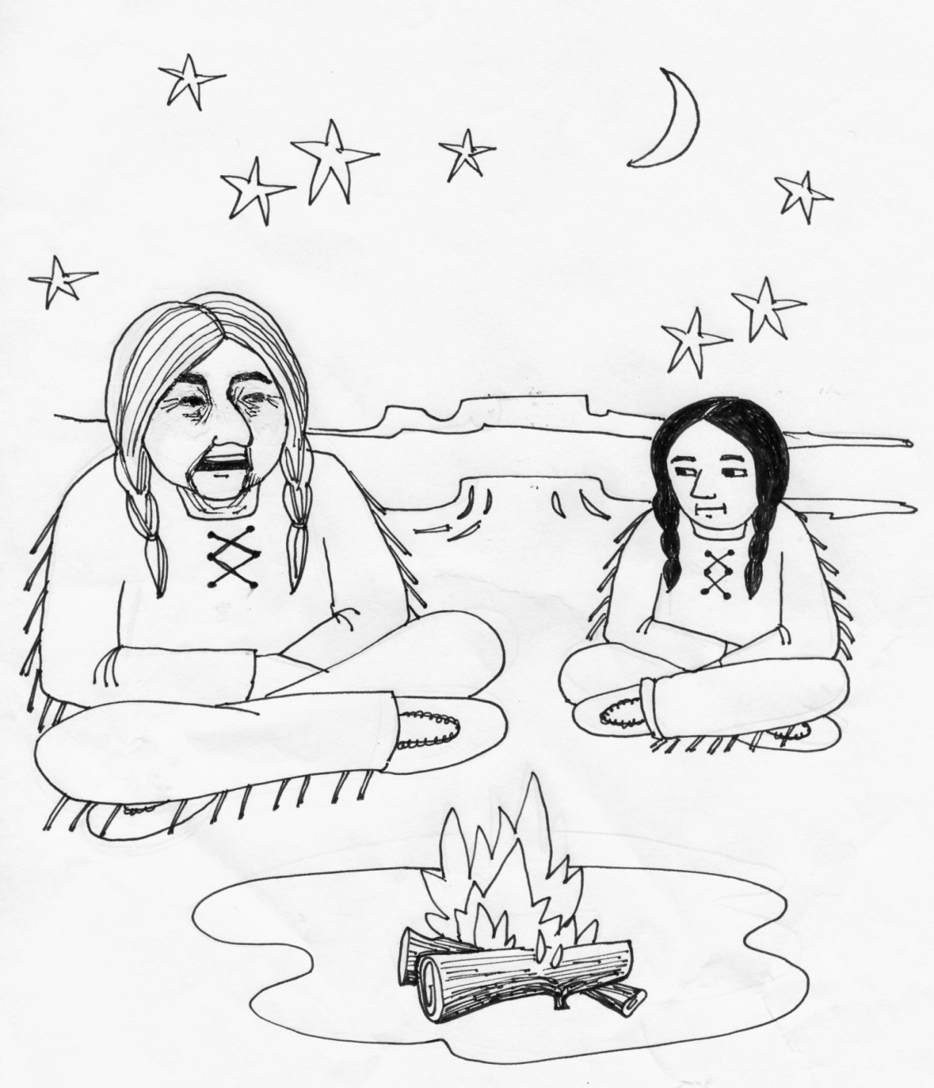
“An elder Cherokee Native American was teaching his grandchild about life. He said to his grandchild …

Slide 49
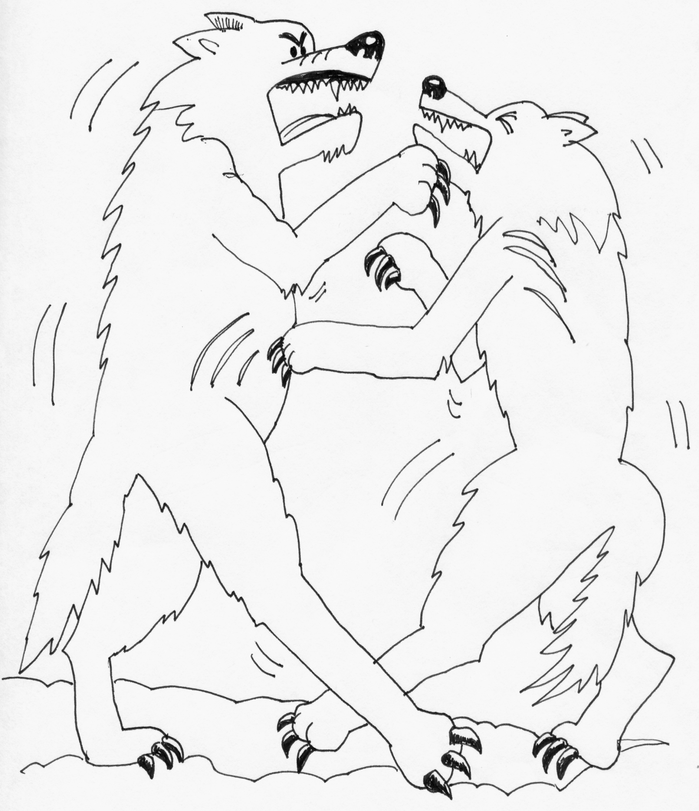
“A fight is going on inside of me … and it is a terrible fight and it is between two wolves.

Slide 50
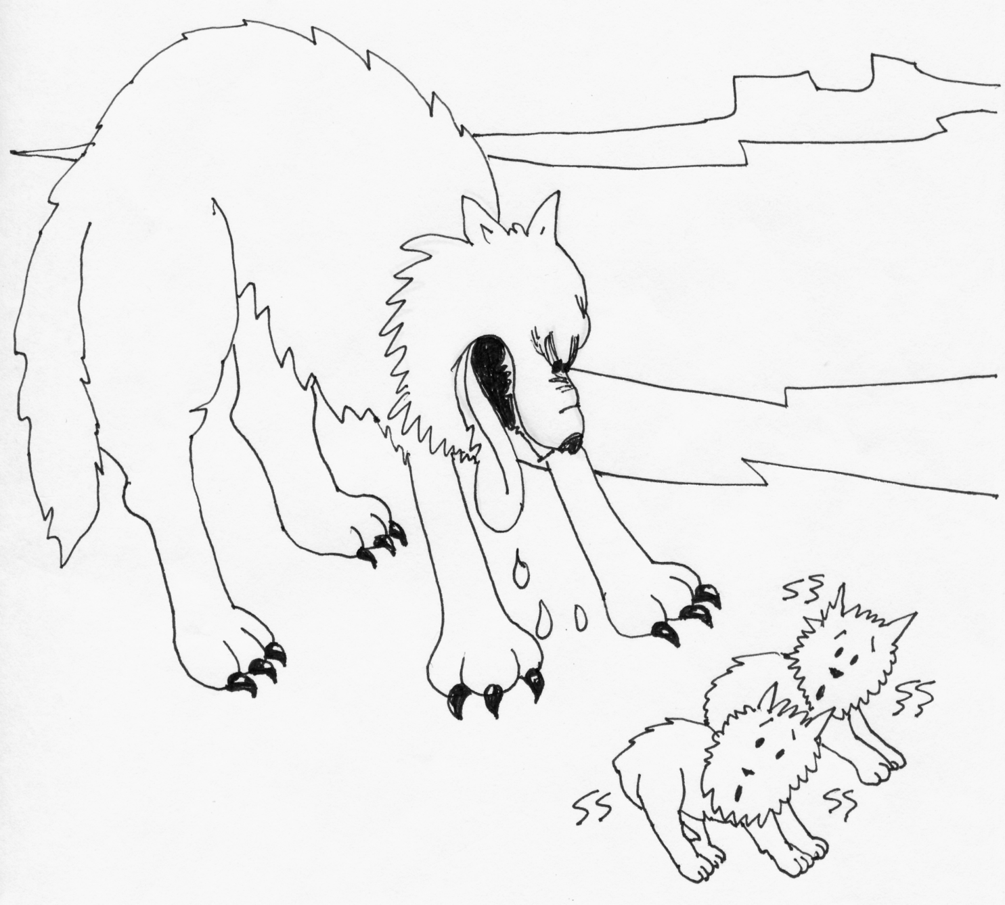
One wolf represents fear, anger, envy, sorrow, regret, greed, arrogance, self-pity, guilt, resentment, inferiority, lies, false pride, superiority and ego.

Slide 51
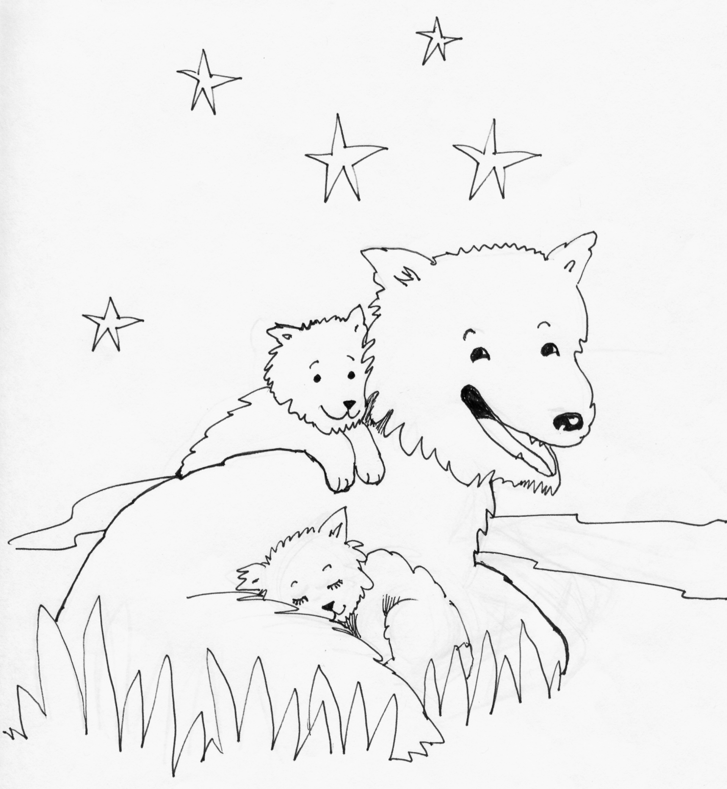
The other wolf stands for honor, joy, peace, love, hope, sharing, serenity, humility, kindness, benevolence, friendship, empathy, generosity, truth, compassion, and faith.

Slide 52
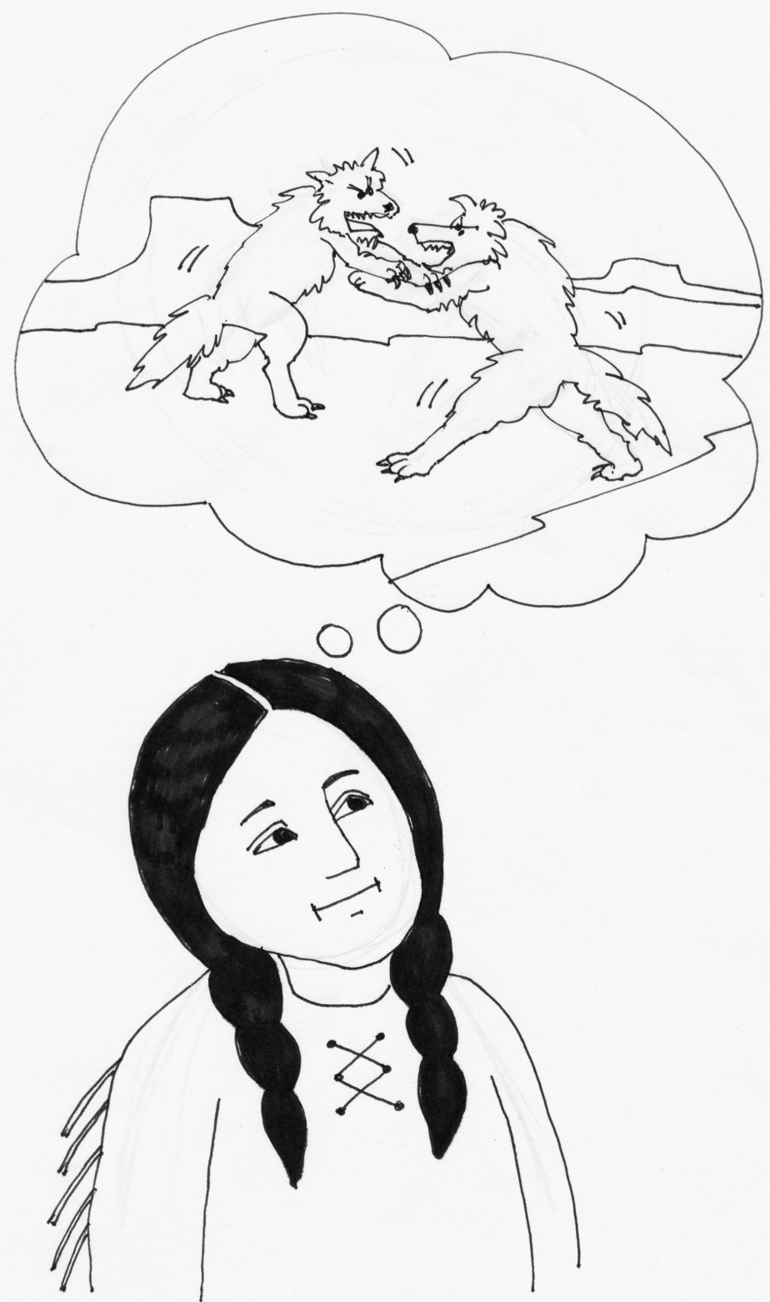
The same fight is going on inside of you and inside of every other human being too.”

Slide 53
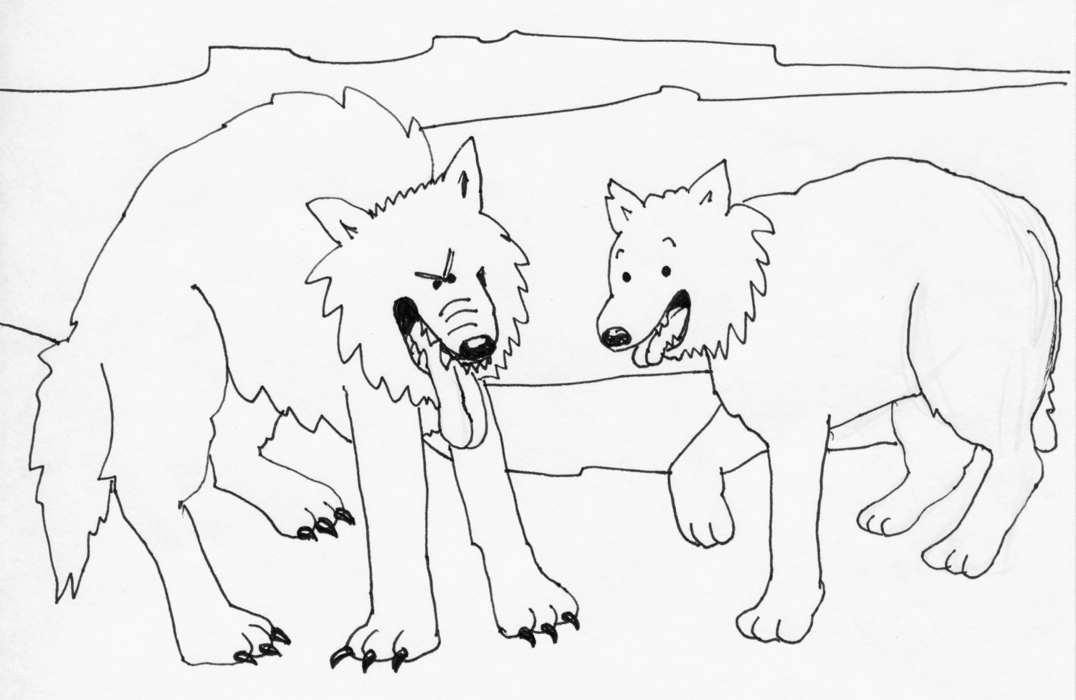
After thinking about it for a minute or two, the grandchild asked her grandfather, “Which wolf will win”?

Slide 54
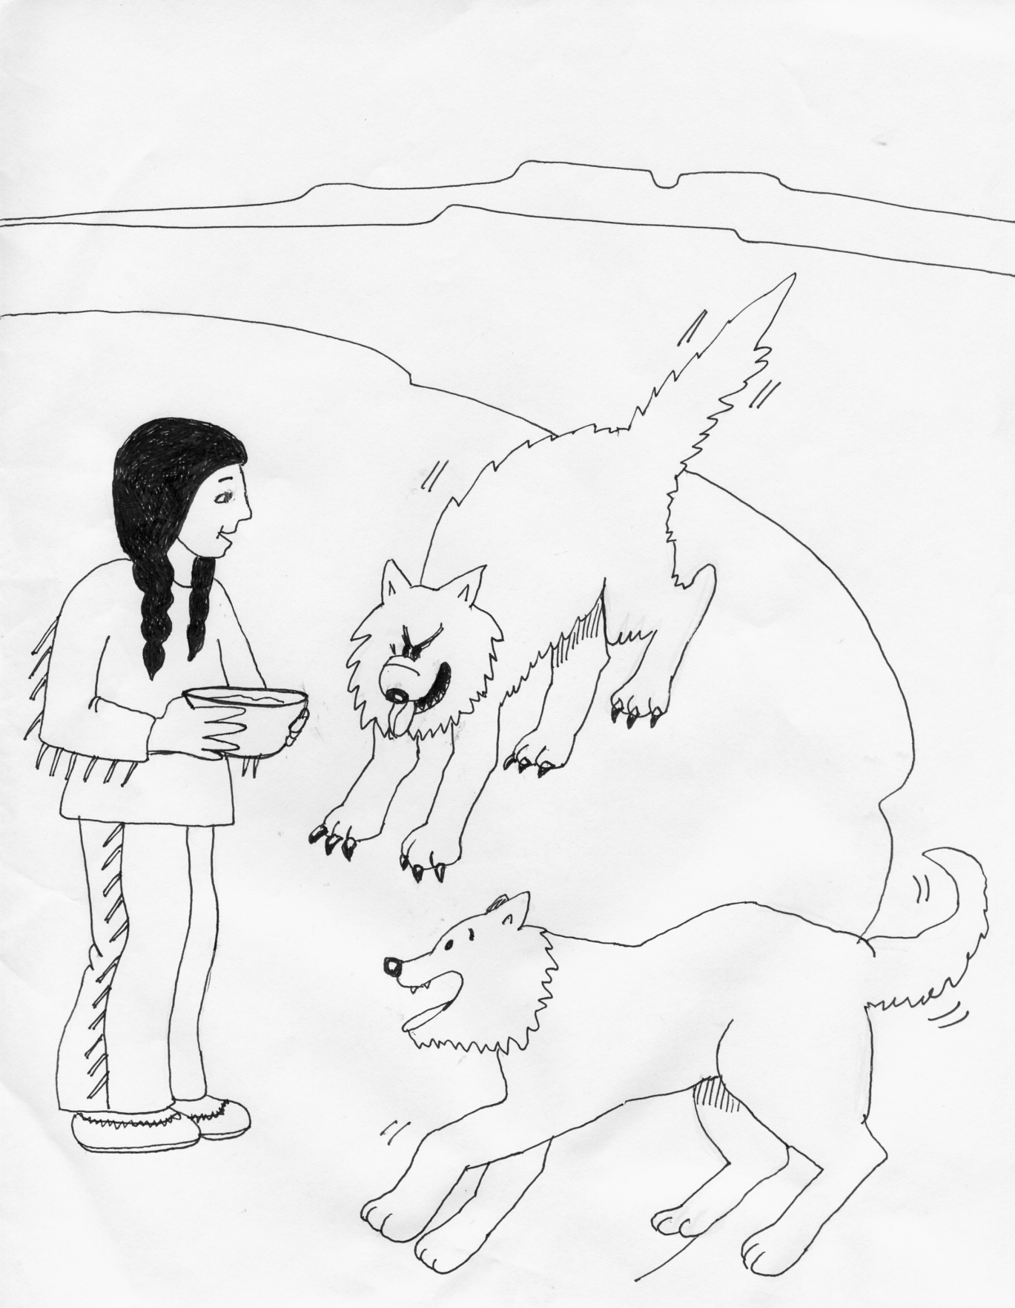
The old man leaned toward his grandchild and whispered …
“The one you feed.”

Slide 55
Adapted or Acquired Self
The intensity and frequency of positive and negative experiences promote the development of an adapted or acquired self.
Positive Adapted Self Negative Adapted Self
Workbook pg. 7-8

Slide 56
What is Child Abuse and Neglect
The following constructs identify the known parenting practices and child rearing behaviors of abusive and neglecting parents.
The Nurturing Parenting Programs are designed to treat and prevent these practices from occurring.

Slide 57
Inappropriate Expectations
Beginning very early in the infant’s life, abusive parents tend to inaccurately perceive the skills and abilities of their children.
Effects:
Low regard for self (concept, esteem, worth)
Feelings of failure
Cannot please others
Angry and anxious attachments

Slide 58
Parental Lack of Empathy
Diminished ability to trust
Inability to form strong attachments
Difficulty in taking care of one’s self
Develops clingy relationships
Focus is on self
Possessive and smothering relationships
Fears of abandonment
Easily led
Difficulty in accepting positive recognition

Slide 59
Strong Belief in Corporal
Punishment
Physical punishment is generally the preferred means of discipline used by abusive parents.
Throughout history, the use of corporal punishment has been well documented.

Slide 60
Why Parents Hit their Children
Parents hit children to teach them right from wrong.
Parents hit children as a form of punishment.
Parents hit children based on religious writings.
Parents hit children as an “act of love.”
Parents hit children because it’s a cultural practice.
Parents hit children to prepare them for the real world

Slide 61
Parent-Child Role Reversal
Parent-child role reversal is an interchanging of traditional role behaviors between a parent and child, so that the child adopts some of the behaviors traditionally associated with parents.

Slide 62
Oppressing Power & Independence
When children’s power and independence are oppressed, they are not allowed to challenge, to voice opinions, or to have choices, but rather are told to “do what they are told to do” without question.

Slide 63
Obedience vs Cooperation
This demand for compliance to parental authority has many limitations:
Obedience breeds powerlessness.
Obedience breeds inadequacy.
Obedience also breeds rebelliousness.
Obedience breeds compliance — to all.
Obedience breeds followers, not leaders.

Slide 64
Part 2: Applying Nurturing Concepts and Practices

Slide 65
Characteristics of a
Competent Professional
Philosopher: what are your beliefs?
Scientist: What latest facts do you know?
Clinician: What do you understand about human behavior?
Practitioner: What skills do you have in facilitating growth in others?

Slide 66
Appropriate Expectations
Value One:
Information and Techniques for Building Positive Self-Worth in Parents and Children
Construct A: Appropriate Developmental Expectations
Appropriate Expectations
Developmental Stages and Self-Worth

Slide 67
Appropriate Expectations
Children’s Brain Development
How Children’s Brains Develop
Teen’s Brain Development
Difference between Male and Female Brains
Ten Ways to Improve Self-Worth
Praise for Being and Doing
Special Motivations
Labels for Self and Others
Positive Self-Talk and Affirmations
Self-Expression

Slide 68
Empathy
Value Two:
Techniques and Strategies for Developing a Sense of Caring and Compassion
Construct B: Empathy
Defining Empathy
Attunement
Bonding and Attachment
Needs and Behavior
Spoiling Children

Slide 69
Empathy
Establishing Nurturing Routines
Personal Touch History
Body Map
Recognizing, Understanding and Communicating Feelings
Typical Feelings of Discomfort
Recognizing and Handling Anger
Recognizing and Handling Stress
Strategies to Reduce Children’s Stress

Slide 70
Discipline with Dignity
Value Three:
Techniques and Strategies for Providing Children and Teens with Dignified Discipline
Construct C: Alternatives to Corporal Punishment
Discipline, Punishment and Rewards
Managing, modifying and encouraging behavior
Danger proof the house

Slide 71
Discipline with Dignity
Establish Clear Family Rules
Choices and Consequences
Verbal and Physical Redirection
Ignoring
Negotiation and Compromise
Praise for Being and Doing
Nurturing Touch
Privileges as Rewards
Objects as Rewards
Allowance as a Positive Consequence

Slide 72
Discipline with Dignity
Loss of Privilege
Being Grounded
Parental Disappointment
Restitution
Time Out
Reasons Why Parents Hit Children

Slide 73
Self Awareness and
Proper Family Roles
Value Four:
Techniques and Strategies for Increasing Self-Awareness and Proper Family Roles
Construct D: Appropriate Family Roles
Anger, Alcohol and Abuse
Families and Alcohol
Violent and Possessive Relationships

Slide 74
Self-Awareness and
Proper Family Roles
Self Expression
Draw Yourself
Draw your Family
Draw Your Parents
Draw Your Children
Examining My Touch History
My Cultural Parenting Traditions
Spirituality
Dating, Love and Rejection

Slide 75
Empowerment
Value Five
Techniques and Strategies for Developing a Healthy Sense of Empowerment
Construct E: Autonomy and Independence
Personal Power and Control
Understanding Power Struggles
Empowerment and the Strong Willed Child
Obedience, Responsibility and Cooperation

Slide 76
Empowerment
Activities to Empower Children:
Giving Children Choices
Choices and Consequences
Transition Time
Bed Time Power Stories
Situational Stories
Body Part Awareness
Scary Touch
Saying No
Owning Your Body and Personal Space

Slide 77
Empowerment
Taking Responsibility
No Blaming Messages
Criticism
Confrontation
Brainstorming
Problem Solving
Decision Making
Negotiating and Compromising
Positive, Negative and Neutral Styles of Communication

Slide 78
Empowerment
Smoking and the Dangers of Second Hand Smoke
Date Rape Drugs

Slide 79
Having Fun
Value Six: Humor, Laughter and Fun
All Nurturing Parenting Constructs
Talking Objects
Reverse Psychology
Role Play
Art, Music and Sports
And other fun family activities

